Slide 1
CSC 236
Tutorial 1 - Daniel Razavi

Slide 2
Apologies Regarding The Slides

Slide 3
New Website

Slide 4


Slide 5
danielrazavi.github.io

Slide 6
Questions about the Problem Set?

Slide 7


Slide 8
Today’s Problem Set

Slide 9

Don’t worry about the bonus yet

Slide 10
Step 1: Base Case

Slide 11
Step 1: Base Case
We know that the smallest number n can be is 1. So we are gonna choose that for our base case.
n = 1 can be written as 2^0
Base Case Proved!

Slide 12
Step 2: Inductive Case

Slide 13
Step 2: Inductive Case
Suppose that n >= 1 and that 1 <= m <= n can be written as the sum of powers of 2.
Some x, y, m
2^{x} + 2^{y} + ... = m
Our Assumption

Slide 14
Step 2: Inductive Case
Suppose that n >= 1 and that 1 <= m <= n can be written as the sum of powers of 2.
Some x, y, m
2^{x} + 2^{y} + ... = m
Our Assumption
Now all we have to do is to prove that n+1 can be written as a sum of powers of 2.

Slide 15
Step 2: Inductive Case
As n+1 >= 2, it is true that there is some k >= 0 such that 1 <= 2^{k} <= n+1.
And pretty much when it comes to this example, there are two cases when you simplify this:
If n+1 = 2^{k}
If n+1 = 2^{k} + p

Slide 16
Step 2: Inductive Case
As n+1 >= 2, it is true that there is some k >= 0 such that 1 <= 2^{k} <= n+1.
And pretty much when it comes to this example, there are two cases when you simplify this:
If n+1 = 2^{k}
If n+1 = 2^{k} + p
Then we are DONE!! Since n+1 can be written as a sum of powers of 2.

Slide 17
Step 2: Inductive Case
As n+1 >= 2, it is true that there is some k >= 0 such that 1 <= 2^{k} <= n+1.
And pretty much when it comes to this example, there are two cases when you simplify this:
If n+1 = 2^{k}
If n+1 = 2^{k} + p
p is some number that
1<= p <= n.
Then we are DONE!! Since n+1 can be written as a sum of powers of 2.

Slide 18
Step 2: Inductive Case
As n+1 >= 2, it is true that there is some k >= 0 such that 1 <= 2^{k} <= n+1.
And pretty much when it comes to this example, there are two cases when you simplify this:
If n+1 = 2^{k}
If n+1 = 2^{k} + p
p is some number that
1<= p <= n.
Then we are DONE!! Since n+1 can be written as a sum of powers of 2.
Now p cannot be n+1 or larger since then we will end up with:
n+1 = 2^{k} + n+1 and this cannot make any sense since k >= 0.

Slide 19
p is some number that
1<= p <= n.
Step 2: Inductive Case
As n+1 >= 2, it is true that there is some k >= 0 such that 1 <= 2^{k} <= n+1.
And pretty much when it comes to this example, there are two cases when you simplify this:
If n+1 = 2^{k}
If n+1 = 2^{k} + p
And by our Inductive Hypothesis, we know that p can be written as the sum of powers of 2.
So both p and 2^{k} can be written as the sum of powers of 2, that means n+1 can be written as a sum of powers of 2
Then we are DONE!! Since n+1 can be written as a sum of powers of 2.

Slide 20
PROVED
p is some number that
1<= p <= n.
Step 2: Inductive Case
As n+1 >= 2, it is true that there is some k >= 0 such that 1 <= 2^{k} <= n+1.
And pretty much when it comes to this example, there are two cases when you simplify this:
If n+1 = 2^{k}
If n+1 = 2^{k} + p
And by our Inductive Hypothesis, we know that p can be written as the sum of powers of 2.
So both p and 2^{k} can be written as the sum of powers of 2, that means n+1 can be written as a sum of powers of 2
Then we are DONE!! Since n+1 can be written as a sum of powers of 2.

Slide 21
Bonus can be a Home Exercise.

Slide 22
Good for you for checking this out at home:) Profs Solution for the Bonus
For the bonus: this is low-priority material for the tutorial, but if there's time:
We begin with this lemma:
\sum_{i=0}^{n-1} 2^i < 2^n.
This can be proved using simple induction, or using the formula for a geometric series:
\sum_{i=0}^{n-1} 2^i
= (1-2^n)/(1-2)
= 2^n-1
< 2^n
Now suppose for contradiction that there are two distinct binary representations b1 and b2 for n >= 1. Moving from highest-power to lowest-power, at some point b1 and b2 must differ in a bit. Suppose that b1 at that first differing position, q, = 1 and b2 in that position = 0. Ignore all bits to the left to produce b1' and b2'.
Consider what remains in both b1' and b2'.
b1' >= 2^q (because bit q is a 1 in b1')
b2' < 2^q (by lemma)
Contradiction: this implies that n is greater than and less than the same value.

Slide 23


Slide 24
Step 1: Base Case

Slide 25
Step 1: Base Case
The height of the tree is 1, and when the height is 1, there is only one leaf note.
Which means the entire tree has an odd number of nodes (well in this case node). Proved.

Slide 26
Step 2: Inductive Case
Suppose that any full binary tree of height 1, 2, ..., h, has an odd number of nodes.
Our Assumption

Slide 27
Step 2: Inductive Case
Suppose that any full binary tree of height 1, 2, ..., h, has an odd number of nodes.
Our Assumption
Now all we have to do is to prove that a full binary tree of height h+1 also has odd number of nodes.

Slide 28
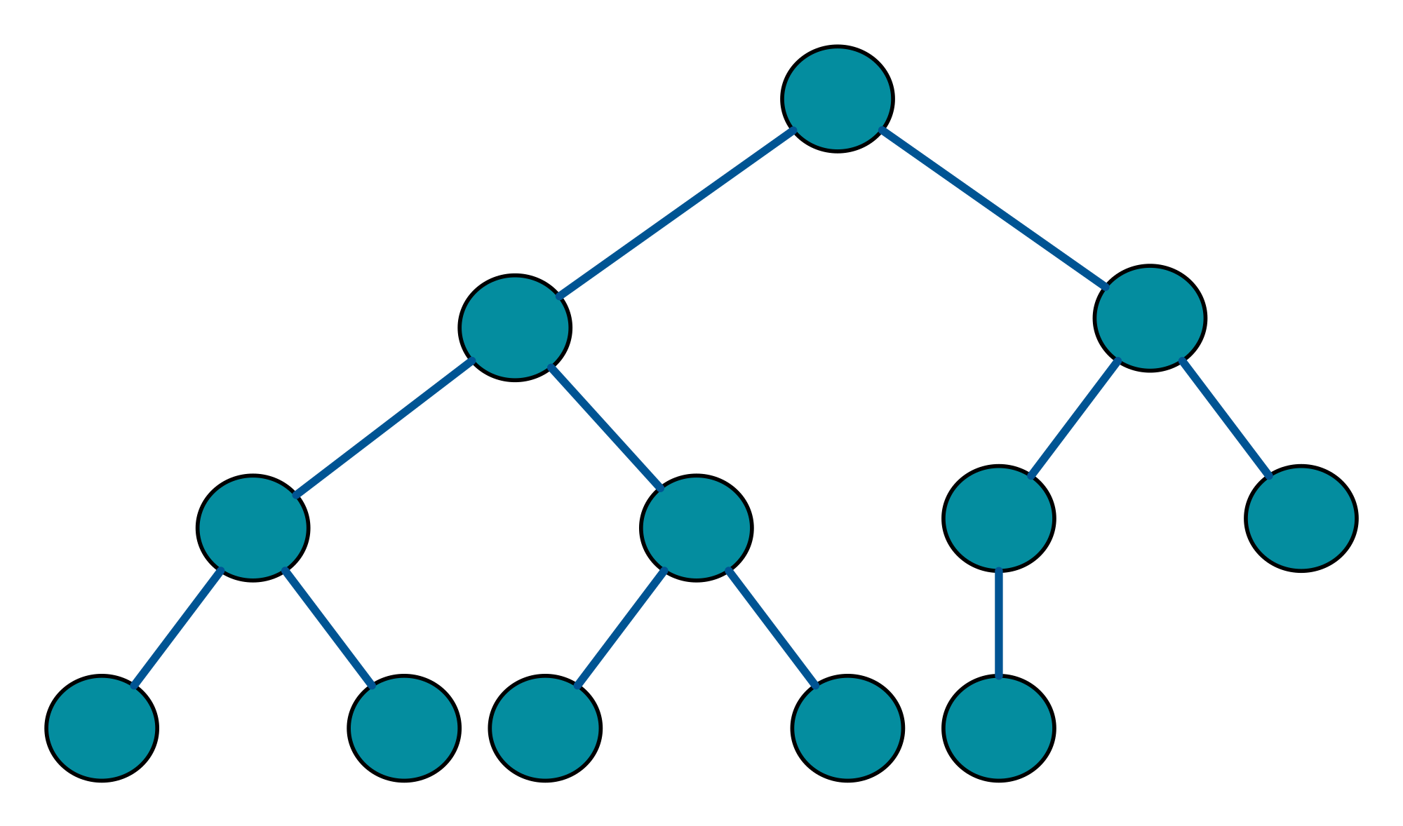
Step 2: Inductive Case
Now we know that at any full binary tree, the root node is supposed to have 2 children. But let's look at it differently. Let's say that the root parent has two other trees as its children.

Slide 29
PROVED
(For Complete Induction)
Step 2: Inductive Case
Now we know that at any full binary tree, the root node is supposed to have 2 children. But let's look at it differently. Let's say that the root parent has two other trees as its children.
We know that the subtrees are full binary trees, so that means that they have odd number of nodes.
(odd) + (odd) + 1 = (even) + 1 = (odd)
Tree 1 (Full Binary Sub-Tree)
Tree 2 (Full Binary Sub-Tree

Slide 30
Step 2: Inductive Case
Now we know that at any full binary tree, the root node is supposed to have 2 children. But let's look at it differently. Let's say that the root parent has two other trees as its children.
We know that the subtrees are full binary trees, so that means that they have odd number of nodes.
(odd) + (odd) + 1 = (even) + 1 = (odd)
Tree 1 (Full Binary Sub-Tree)
Tree 2 (Full Binary Sub-Tree

Slide 31
The proof is very similar by structural induction. We have a recursive definition for T, the set of nonempty binary trees:
Any single node is in T
If t1 and t2 in T, then a new tree with root r and subtrees t1 and t2 is in T.
Tree 1 (Full Binary Sub-Tree)
Tree 2 (Full Binary Sub-Tree
Really Similar to the Example in the Readings (Notes.pdf) on Page 19
Notes:
https://www.youtube.com/watch?v=VWIDwHCGJDQ
https://www.youtube.com/watch?v=p8aUo1Ml4Ng

Slide 32
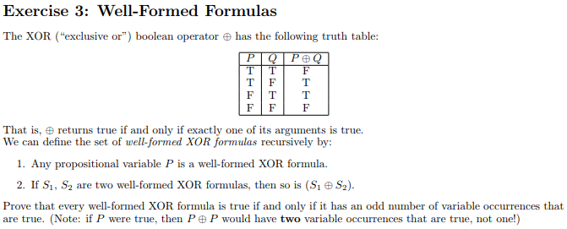

Slide 33
Base Case: a propositional variable P.
If P has 0 occurrences of true variables, then P is false as required. Otherwise, P has an odd number of true variables (1), and P is true as required.

Slide 34
Inductive case:
suppose that s1 and s2 are two well-formed xor formulas.
Then, using the IH twice:
s1 is true iff an odd number of its variables is set to true.
s2 is true iff an odd number of its variables is set to true.

Slide 35
Inductive case:
suppose that s1 and s2 are two well-formed xor formulas.
Then, using the IH twice:
s1 is true iff an odd number of its variables is set to true.
s2 is true iff an odd number of its variables is set to true.
We must prove that:
(s1 xor s2) is true if and only if an odd number of its variables is set to true.

Slide 36
If you remember from MAT102:
This question brings up two conditions with it.
If (s1 xor s2) is true, then an odd number of its variables is set to true.
We must prove that:
(s1 xor s2) is true if and only if an odd number of its variables is set to true.
If an odd number of variables is true, then (s1 xor s2) is true.

Slide 37
If (s1 xor s2) is true, then an odd number of its variables is set to true.
For (s1 xor s2) to be true, exactly one of s1 or s2 is true and the other is false.
Then, by the IH, one of s1 and s2 has an odd number of true variables and the other has an even number of true variables.
So, (s1 xor s2) has (odd + even) = odd number of true variables.
We must prove that:
(s1 xor s2) is true if and only if an odd number of its variables is set to true.

Slide 38
If an odd number of variables is true, then (s1 xor s2) is true.
There are an odd number of true variables, so one of s1 and s2 must have an odd number of true variables and the other must have an even number of true variables.
Two odds add up to an even, and two evens add up to an even, so those can't happen.
But then, by the IH, one of s1 and s2 is true and the other is false. By the definition of xor, (s1 xor s2) is true.
We must prove that:
(s1 xor s2) is true if and only if an odd number of its variables is set to true.

Slide 39
If an odd number of variables is true, then (s1 xor s2) is true.
There are an odd number of true variables, so one of s1 and s2 must have an odd number of true variables and the other must have an even number of true variables.
Two odds add up to an even, and two evens add up to an even, so those can't happen.
But then, by the IH, one of s1 and s2 is true and the other is false. By the definition of xor, (s1 xor s2) is true.
We must prove that:
(s1 xor s2) is true if and only if an odd number of its variables is set to true.
We mention this due to the whole “uniqueness” thing

Slide 40
CSC 236
Tutorial 1 - Daniel Razavi

